Slide 1
Statistics Part - III
LaxmiNarayen

Slide 2
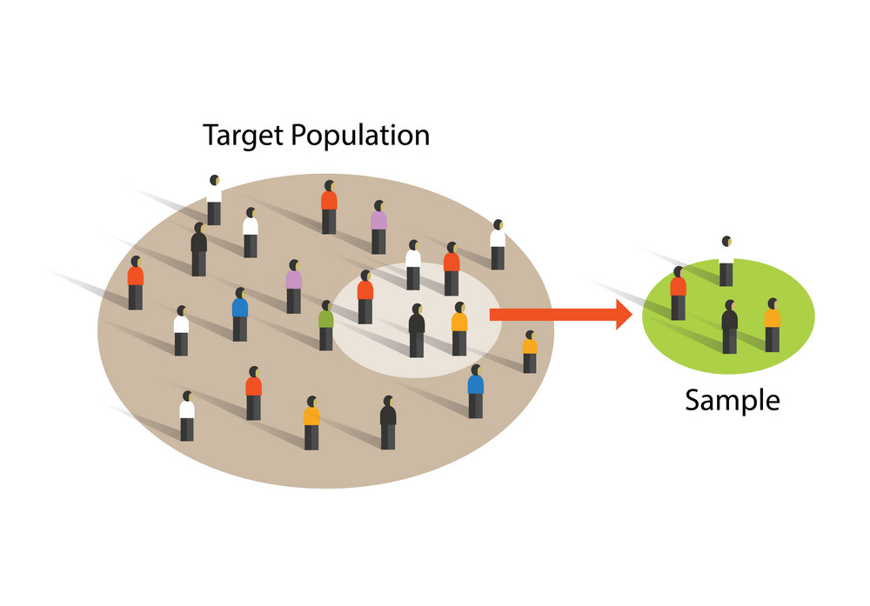
Population and sAmple
Population
The entire set of possible cases
Sample
A subset of the population from which data are collected

Slide 3
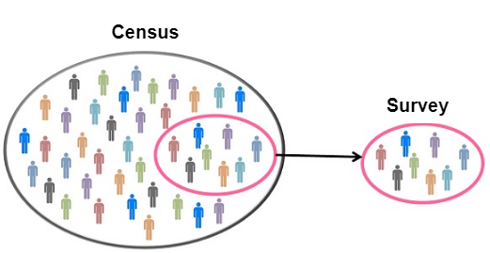
Examples for population and sample

Slide 4
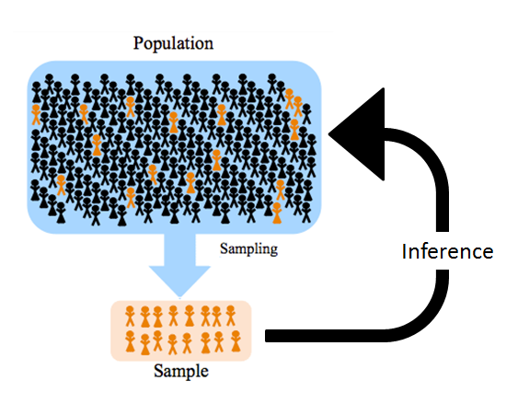
Statistic and parameter
Statistic
A measure concerning a sample (e.g., sample mean)
Parameter
A measure concerning a population (e.g., population mean)

Slide 5
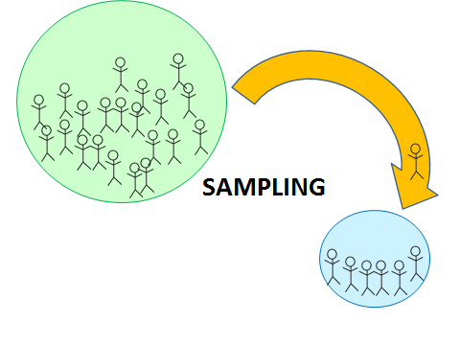
Sampling
Process of selecting a small number of elements from a much larger set

Slide 6
Sampling bias
Three types of Sampling bias:
SELF- SELECTION BIAS
UNDER-COVERAGE BIAS
Survivorship bias
Response Bias
Non – Response bias

Slide 7

Self – Selection bias
This is the most common type of Bias
This type of bias favors those members of a population who are more inclined and able to answer polls.

Slide 8

Example of self – selection bias
An online survey about computer use is likely to attract people more interested in technology than is typical.

Slide 9

Example of self selection bias
a university newspaper ran an ad asking for students to volunteer for a study in which the details of their fitness would be discussed.

Slide 10

Example for Self Selection bias
An online survey about a sports team
Only people who feel strongly about the team will answer the survey.

Slide 11
Under coverage bias
A common type of sampling bias is to sample too few observations from a segment of the population.

Slide 12

Example for Under coverage bias
A hospital survey of employees conducted during daytime hours
Neglects to poll people who work the night shift.

Slide 13

The Literary Digest Case Study
A commonly-cited example of under coverage is the poll taken by the Literary Digest in 1936 that indicated that Landon would win an election against Roosevelt by a large margin when, in fact, it was Roosevelt who won by a large margin.
Notes:
A common explanation is that poorer people were under covered because they were less likely to have telephones and that this group was more likely to support Roosevelt.
A detailed analysis by Squire (1988) showed that it was not just an undercoverage bias that resulted in the faulty prediction of the election results. He concluded that, in addition to the undercoverage described above, there was a nonresponse bias (a form of self-selection bias) such that those favoring Landon were more likely to return their survey than were those favoring Roosevelt.

Slide 14
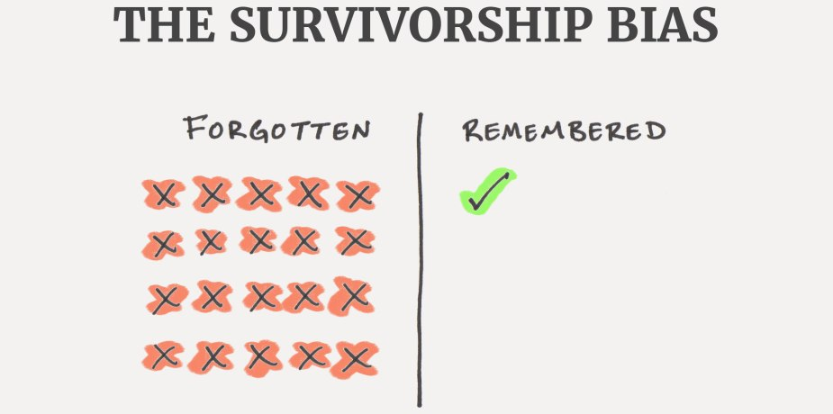
Survivor Bias
Survivorship bias is a tendency to only focus on the survivors rather than everybody.
This can due to their lack of visibility which can, in turn, lead to false conclusions.
Notes:
Which can also mean that people tend to focus more on the winners rather than the losers.

Slide 15

Example for survivor bias
In World War I , statistician Abraham Wald worked for America’s Statistical Research Group (SRG)

Slide 16
Example for survivor bias
One problem the SRG worked on was to examine the distribution of damage to aircraft by enemy fire and to advise the best placement of additional armor.

Slide 17
Example for survivor bias
Common logic was to provide greater protection to parts that received more damage.

Slide 18
Example for survivor bias
Wald saw it differently – he felt that damage must be more uniformly distributed and that aircraft that could return had been hit in less vulnerable parts.

Slide 19
Example for survivor bias
Wald proposed that the Navy reinforce the areas where returning aircraft were undamaged, since those were areas that, if hit, would cause the plane to be lost!

Slide 20

Response bias
Response bias (also called survey bias) is the tendency of a person to answer questions on a survey untruthfully or misleadingly.

Slide 21

Examples of response bias
Fatigue: giving a survey when a person is tired or ill may affect their responses.

Slide 22

Examples of response bias
Faulty recall: asking a person about an event that happened in the distant past may result in erroneous responses.

Slide 23

Non – Response bias
This occurs when sampling units selected for a sample are not interviewed. Sampled units typically do not respond because they are unable, unavailable, or unwilling to do so.

Slide 24

Examples for non response bias
You have a smartphone survey for older adults.

Slide 25

Benefits of sampling
A reasonably sized (>30) random sample will almost always reflect the population.
But how do we select these members, and avoid bias?

Slide 26
Types of Sampling
Random
Stratified Random
Cluster

Slide 27
Random Sampling
As its name suggests, random sampling means every member of a population has an equal chance of being selected.

Slide 28
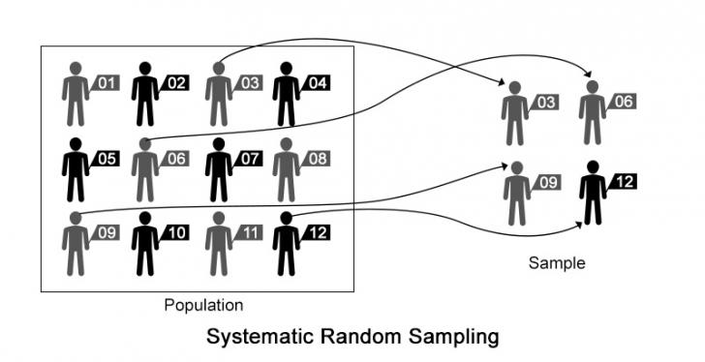
Examples for random sampling
Notes:
As its name suggests, random sampling means every member of a population has an equal chance of being selected.
However, since samples are usually much smaller than populations, there’s a chance that entire demographics might be missed.

Slide 29
Stratified Random sampling
Stratified random sampling ensures that data in population are adequately represented in terms of groups.

Slide 30
steps for stratified random sampling
First, divide the population into segments based on some characteristic.
Next, take random samples from each group

Slide 31
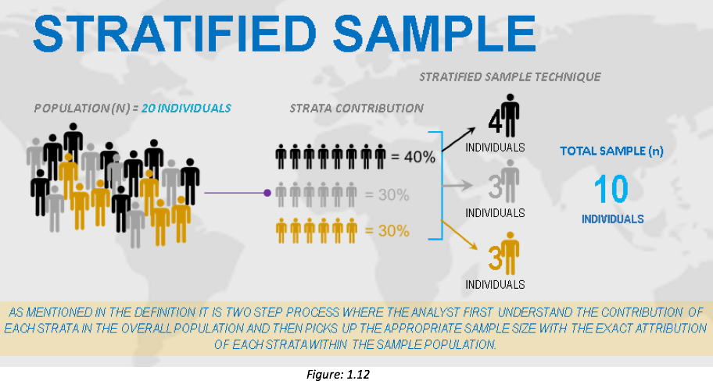
Examples for stratified random sampling

Slide 32
Example of stratified random sampling
A Company wanted to conduct a survey of customer satisfaction. They can only survey 10% of customers. So to ensure every age group is fairly represented

Slide 33

Example of stratified random sampling
The customer breakdown by age group is as follows:
20-29 | 30-39 | 40-49 | 50+ | TOTAL
1400 | 4450 | 3200 | 950 | 10,000
stratum
strata

Slide 34
Example of stratified random sampling
To get the 10% we take 10% from each group
20-29 | 30-39 | 40-49 | 50+ | TOTAL
1400 | 4450 | 3200 | 950 | 10,000
140 | 445 | 320 | 95 | 1,000

Slide 35

Clustering
Cluster sampling refers to a type of sampling method .
With cluster sampling, the researcher divides the population into separate groups, called clusters. Then, a simple random sample of clusters is selected from the population.
Notes:
A third – and often less precise – method of sampling is clustering
The idea is to break the population down into groups and sample a random selection of groups, or clusters.
Usually this is done to reduce costs.

Slide 36
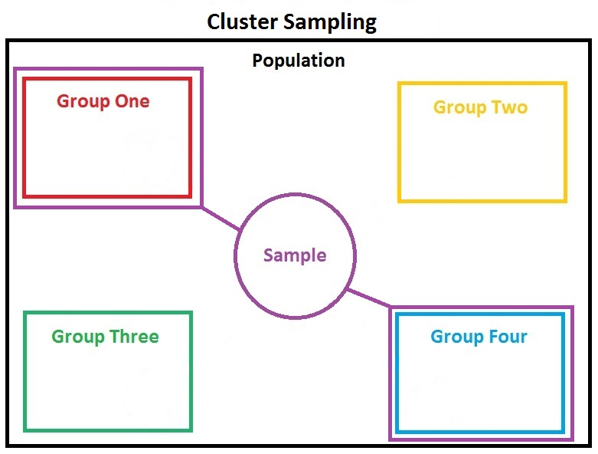
Example for cluster sampling

Slide 37
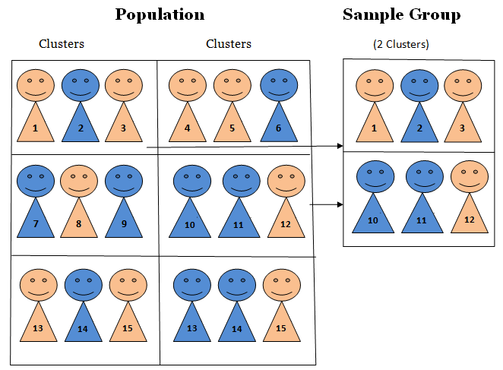
Example for cluster sampling

Slide 38
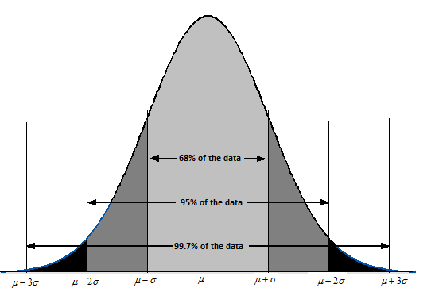
Normal Distribution extended
Characteristics of a normal curve:
The values of mean, median and mode are same

Slide 39
Normal Distribution extended
Characteristics of a normal curve:
It shows a symmetric distribution as 50% of the data set lies on the left side of the mean and 50% of the data set lies on the right side of the mean.

Slide 40
Normal Distribution extended
Characteristics of a normal curve:
Empirical rule: 68% of the data fall within μ ±σ, 95% of the data fall within μ ± 2 σ and 99.7% of the data fall within μ ± 3 σ

Slide 41
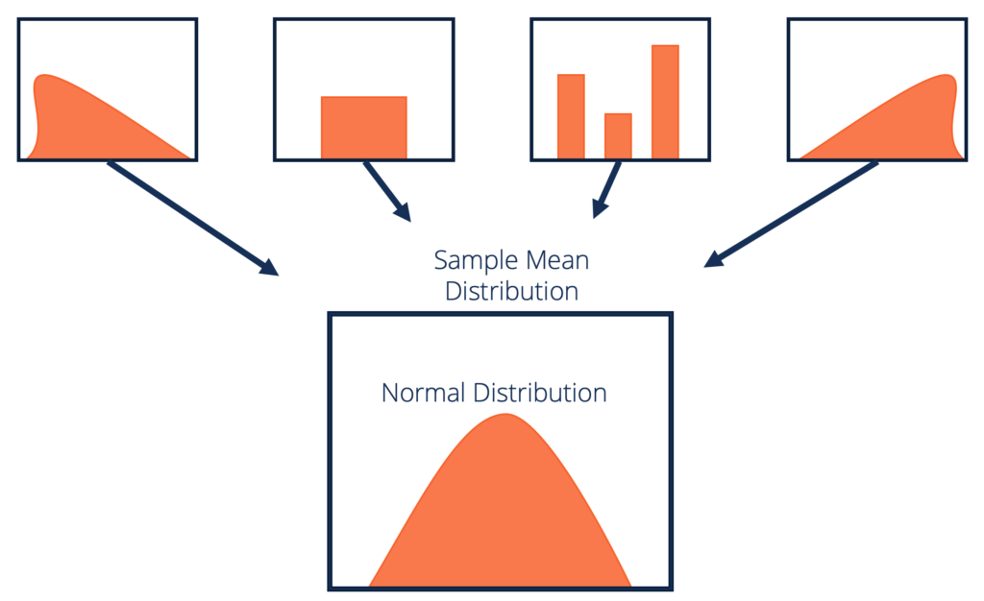
Central Limit Theorem
What makes sampling such a good statistical tool is the Central Limit Theorem
The CLT states that the mean values from a group of samples will be normally distributed about the population mean, even if the population itself is not normally distributed.

Slide 42
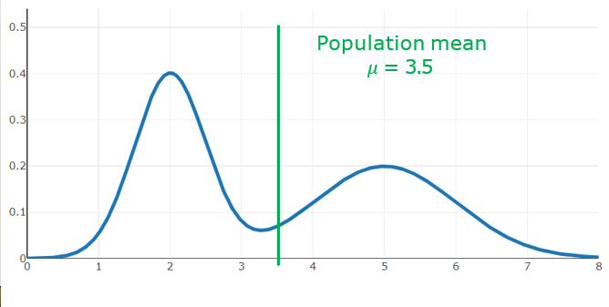
Example for clt
Consider this example distribution of the population with mean 3.5

Slide 43
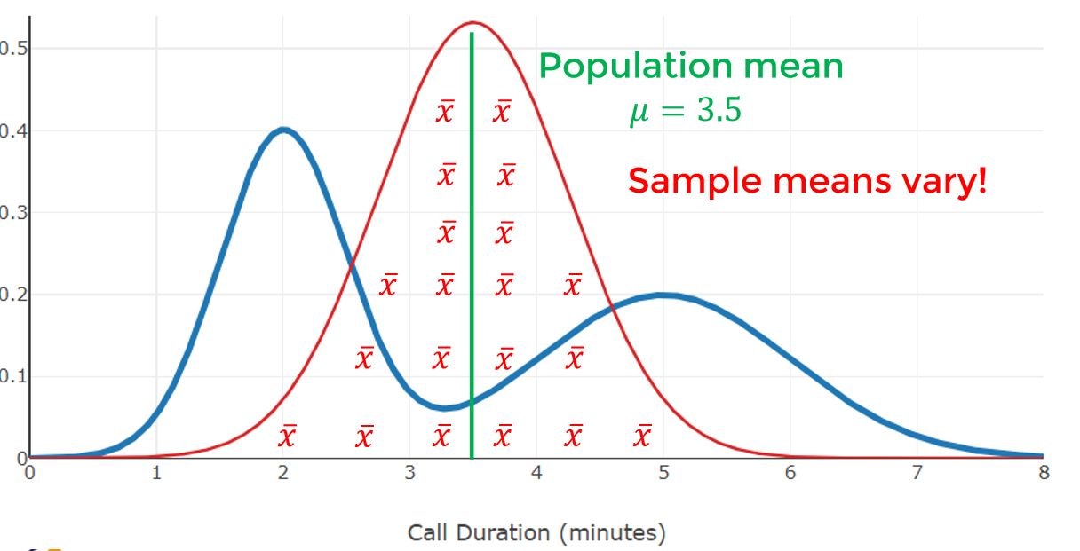
Example for clt
Here when we take different samples from the population and find their means we would get the following distribution

Slide 44
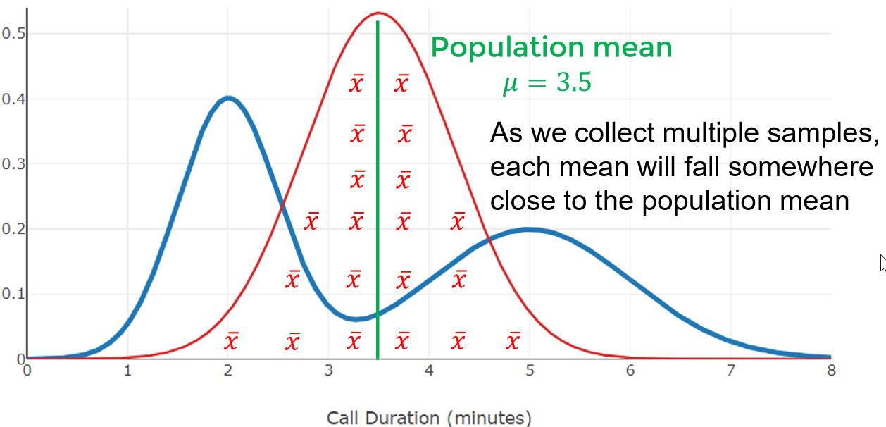
Example for clt
That is 95% of all the sample means should fall within 2𝜎 of the population mean
Notes:
That is 95% of all the sample means should fall within 2𝜎 of the population mean

Slide 45
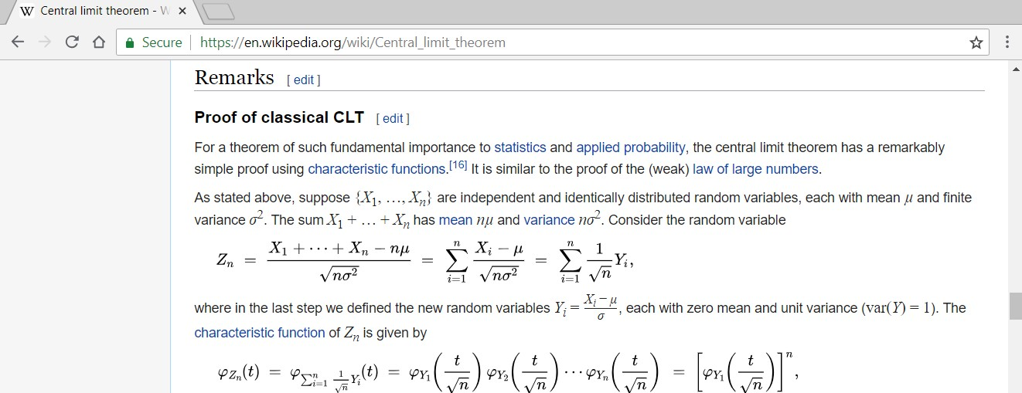

Proof of CLT Available on Wikipedia For those who are curious, the full proof of the Central Limit Theorem is available at
https://en.wikipedia.org/wiki/Central_limit_theorem

Slide 46
Standard Error mean
What is Standard deviation?
Describes how wide individuals values are deviated from the population mean
Standard error of the mean describes how far the sample mean may be deviated from the population mean

Slide 47
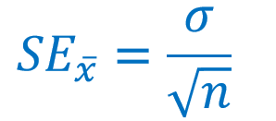
Standard Error of mean
If the population standard deviation 𝜎 is known, then the sample standard error of the mean can be calculated as:

Slide 48

Example of standard Error
An IQ Test is designed to have a mean score of 100 with a standard deviation of 15 points.
If a sample of 10 scores has a mean of 104, can we assume they come from the general population?

Slide 49
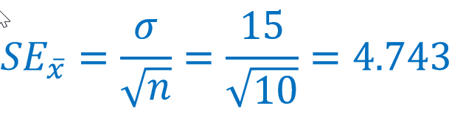
Example of standard Error
Sample of 10 IQ Test scores:
𝑛 = 10 𝑥 = 104 𝜎 = 15
68% of 10-item sample means are expected to fall between 95.257 and 104.743

Slide 50
Z-Score or Standard Score
Simply put, a z-score is the number of standard deviations from the mean a data point is.
But more technically it’s a measure of how many standard deviations below or above the population mean a raw score is.
z = (x – μ) / σ

Slide 51
Example for Z-score and standard score
Let’s say you have a test score of 175. The test has a mean (μ) of 150 and a standard deviation (σ) of 25. Assuming a normal distribution, your z score would be and how many percent of the people scored below you:
z = (x – μ) / σ = 175 – 150 / 25 = 1
50 + 34 = 84%
Notes:
.

Slide 52
Examples for Z-Score or Standard Score
Let’s say you have a test score of 190. The test has a mean (μ) of 150 and a standard deviation (σ) of 25. Assuming a normal distribution, your z score would be and how many percent of the people scored below you:
z = (x – μ) / σ = 190 – 150 / 25 = 1.6.
We will look at the Z – Table

Slide 53
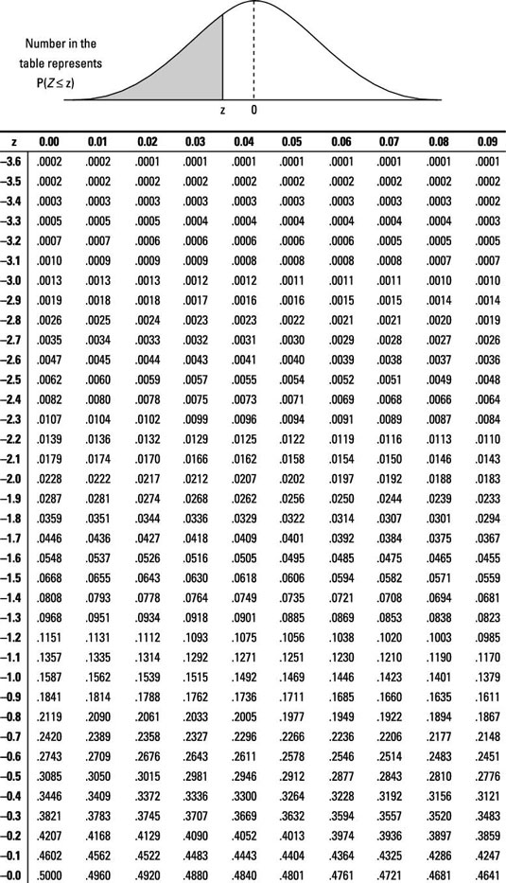
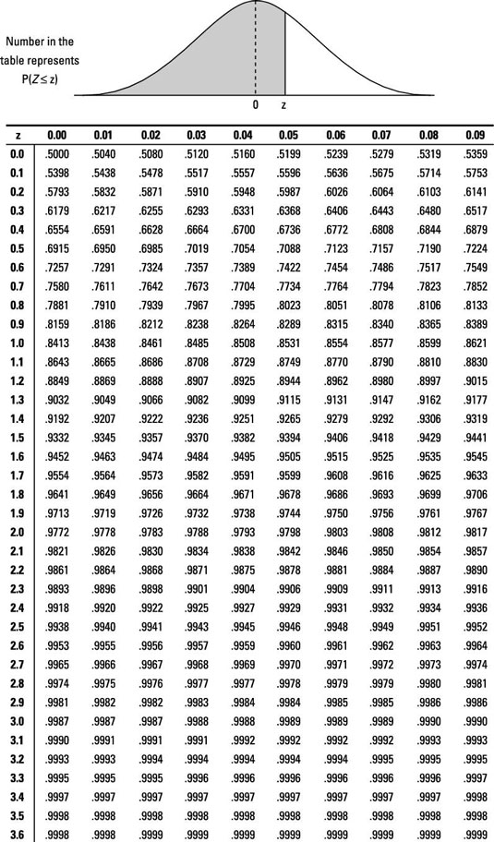
Z-table
Now from the results to understand how many people have scored below us we can look up the z-table and tell the value in percentage.

Slide 54
Examples for Z-Score or Standard Score
Let’s say you have a test score of 190. The test has a mean (μ) of 150 and a standard deviation (σ) of 25. Assuming a normal distribution, your z score would be and how many percent of the people scored below you:
We will look at the Z – Table

Slide 55
Example for Z – Table
You take up the CAT examination and score 1100. The mean score for the SAT is 1026 and standard deviation is 209. How well did you perform than the average test taker?

Slide 56
Margin of error
A small amount that is allowed for in case of miscalculation or change of circumstances.
ME = z * SE
Where z is the z score and SE is the Standard Error

Slide 57
Confidence Interval
A Confidence Interval is a range of values we are fairly sure our true value lies in.

Slide 58
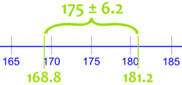
Example for Confidence interval
We measure the heights of 40 randomly chosen men, and get a mean height of 175cm,
We also know the standard deviation of men's heights is 20cm.
The 95% Confidence Interval (we show how to calculate it later) is:

Slide 59
Steps for finding Confidence Interval
Step 1: find the number of observations n, calculate their mean X, and standard deviations
Using our example:
Number of observations: n = 40
Mean: X = 175
Standard Deviation: s = 20

Slide 60
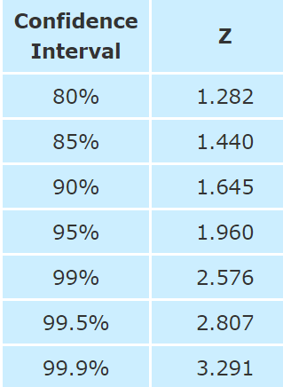
Steps for finding Confidence Interval
Step 2: decide what Confidence Interval we want: 95% or 99% are common choices. Then find the "Z" value for that Confidence Interval here:
For 95% the Z value is 1.960

Slide 61
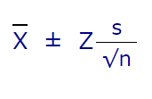
Steps for finding Confidence Interval
Step 3: use that Z in this formula for the Confidence Interval
And we have:
175 ± 1.960 × 20√40
Which is:
175cm ± 6.20cm
In other words: from 168.8cm to 181.2cm

